Slide 1
Professional Portfolio
STUDENT NAME: RAGAVARSHINI . S
REGISTER NO AND NMID: asunm1729212406036
DEPARTMENT: BACHELOR OF COMPUTER APPLICATION
COLLEGE: SRI BALAJI PRINCE ARTS AND SCIENCE COLLEGE/ UNIVERSITY OF MADRAS

Slide 2
PROJECT TITLE
PROFESSIONAL
PORTFOLIO

Slide 3


AGENDA
Problem Statement
Project Overview
End Users
Tools and Technologies
Portfolio design and Layout
Features and Functionality
Results and Screenshots
Conclusion
Github Link
3/21/2024 Annual Review

Slide 4

Problem Statement
In today’s competitive environment, a traditional paper resume does not fully reflect a candidate’s skills and potential.
Recruiters and clients often prefer a digital platform that is interactive, professional, and easy to access.
Many individuals lose opportunities because they lack a strong online identity.

Slide 5

Project Overview
This project is a responsive and professional portfolio website designed to present an individual’s profile in a structured and engaging way. The portfolio acts as a digital resume + personal brand hub, showcasing technical expertise, projects, achievements, and contact details in one place. It is developed using modern web technologies to ensure smooth performance and accessibility across all devices
Goal: Build a career-ready platform that creates a lasting impression on recruiters and employers.

Slide 6

WHO ARE THE END USERS?
Students & Freshers → To showcase academic projects, internships, and technical skills.
Job Seekers → To stand out in interviews by sharing a live portfolio link.
Freelancers → To display services, projects, and client work to attract global opportunities.
Recruiters & HR Managers → To quickly evaluate candidates with a professional and interactive format.

Slide 7

TOOLS AND TECHNIQUES
Languages: HTML5, CSS3, JavaScript
Frameworks: Bootstrap for responsive design
Editor: Visual Studio Code
Version Control: Git & GitHub
Deployment: GitHub Pages

Slide 8
POTFOLIO DESIGN AND LAYOUT
The portfolio is designed with a clean, minimal, and professional layout to ensure both recruiters and clients can easily navigate and understand the profile.
Sections Included:
Header & Navigation Bar – Simple and accessible menu for smooth navigation.
Hero Section – A professional introduction with name, role, and tagline.
About Me – A brief description highlighting background and career goals.
Skills Section – Visual representation of technical and soft skills.
Projects Showcase – Interactive cards with project details, images, and links.
Achievements/Certifications – Quick view of milestones and recognitions.
Contact Form – Easy way for recruiters or clients to connect directly.
Footer – Social media links, GitHub link, and copyright note.
8

Slide 9
FEATURES AND FUNCTIONALITY
Fully responsive design that adapts to mobile, tablet, and desktop.
Well-organized sections: Home, About, Skills, Projects, Contact.
Interactive project cards with links to GitHub or live demos.
Smooth animations and transitions for a modern user experience.
Contact form integrated with email alerts.
Professional theme with clean typography and balanced colors.
SEO-friendly structure for better online reach.

Slide 10
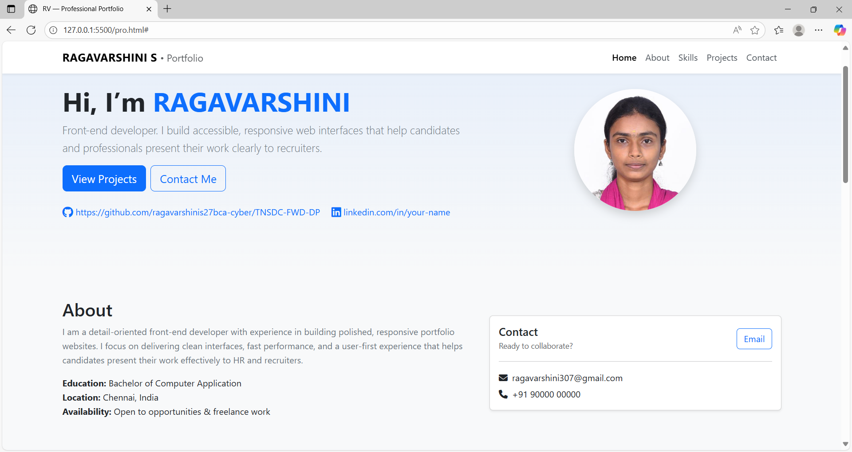

RESULTS AND SCREENSHOTS
3/21/2024 Annual Review
10

Slide 11
CONCLUSION
This project proved that a portfolio is more than just a website – it is a career tool.
It highlights both technical ability and creativity, while building a strong personal brand.
The portfolio not only enhances job opportunities but also reflects professionalism, confidence, and readiness for the industry.
11

